Slide 1

201X
市场部营销计划
The user can demonstrate on a projector or computer, or print the presentation and make it into a film to be used in a wider field
WWW.IBAOTU.COM

Slide 2
201X
市场部营销计划
The user can demonstrate on a projector or computer, or print the presentation and make it into a film to be used in a wider field
WWW.IBAOTU.COM

Slide 3
CONTENTS
工作总结概述
工作完成情况
工作存在不足
下步工作计划
print the presentation and make it into a film a wider field
print the presentation and make it into a film a wider field
print the presentation and make it into a film a wider field
print the presentation and make it into a film a wider field
WWW.IBAOTU.COM

Slide 4
PART 01
工作总结概述
The user can demonstrate on a projector or computer or print the it into a film to be used in a wider field

Slide 5

PART 01
工作总结概述
标题文字添加
The user can demonstrate on a projector or computer, or presentation and make it film to be used in a wider field
标题文字添加
The user can demonstrate on a projector or computer, or presentation and make it film to be used in a wider field

Slide 6
PART 01
工作总结概述
标题文字添加
The user can demonstrate on a projector or computer, or presentation and make it film to be used in a wider field
标题文字添加
The user can demonstrate on a projector or computer, or presentation and make it film to be used in a wider field
Title One
81%
标题文字添加
Title Two
74%
Title Three
70%
The user can demonstrate on a projector or computer, or presentation and make it film to be used in a wider field
TEXT HERE
Supporting text here

Slide 7
PART 01
工作总结概述
标题文字添加
The user can demonstrate on a projector or computer, or presentation and make it film to be used in a wider fieldThe user can demonstrate on a projector or computer, or presentation and make The user can demonstrate on a projector or computer,
60%
40%
标题文字添加
标题文字添加
The user can demonstrate on a projector or coma wider puter, or presentation and make it film to be used in a wider field
The user can demonstrate on a projector or coma wider puter, or presentation and make it film to be used in a wider field
30%
52%
标题文字添加
标题文字添加
The user can demonstrate on a projector or coma wider puter, or presentation and make it film to be used in a wider field
The user can demonstrate on a projector or coma wider puter, or presentation and make it film to be used in a wider field

Slide 8
PART 01
工作总结概述
标题文字添加
The user can demonstrate on a projector or computer, or presentation and make it film to be used in a wider field
标题文字添加
The user can demonstrate on a projector or computer, or presentation and make it film to be used in a wider field
2018
2019
2016
标题文字添加
标题文字添加
The user can demonstrate on a projector or computer, or presentation and make it film to be used in a wider field
2017
The user can demonstrate on a projector or computer, or presentation and make it film to be used in a wider field

Slide 9
PART 01
工作总结概述
标题文字添加
标题文字添加
The user can demonstrate on a projector or computer, or presentation and make it film to be used in a wider field
The user can demonstrate on a projector or computer, or presentation and make it film to be used in a wider field
01
02
04
03
标题文字添加
The user can demonstrate on a projector or computer, or presentation and make it film to be used in a wider field
标题文字添加
The user can demonstrate on a projector or computer, or presentation and make it film to be used in a wider field

Slide 10
PART 02
工作完成情况
The user can demonstrate on a projector or computer or print the it into a film to be used in a wider field

Slide 11
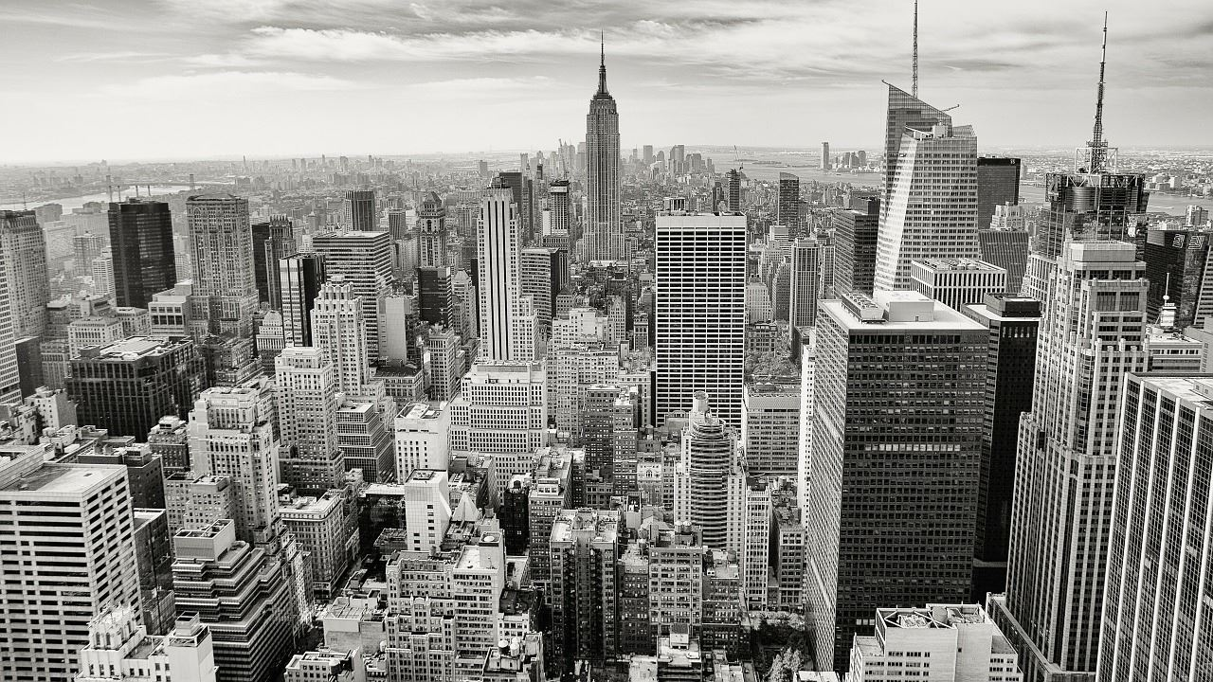
PART 02
工作完成情况
标题文字添加
The user can demonstrate on a projector or computer, or presentation and make it film to be used in a wider fieldThe user can demonstrate on a projector or computer, or presentation and make The user can demonstrate on a projector or computer,
标题文字添加
标题文字添加
标题文字添加
The user can demonstrate on a projector or computer, or presentation and make it film to be used in a wider field
The user can demonstrate on a projector or computer, or presentation and make it film to be used in a wider field
The user can demonstrate on a projector or computer, or presentation and make it film to be used in a wider field

Slide 12

PART 02
工作完成情况
标题文字添加
标题文字添加
The user can demonstrate on a projector or computer, or presentation and make it film to be used in a wider field
The user can demonstrate on a projector or computer, or presentation and make it film to be used in a wider field
标题文字添加
标题文字添加
The user can demonstrate on a projector or computer, or presentation and make it film to be used in a wider field
The user can demonstrate on a projector or computer, or presentation and make it film to be used in a wider field
标题文字添加
标题文字添加
The user can demonstrate on a projector or computer, or presentation and make it film to be used in a wider field
The user can demonstrate on a projector or computer, or presentation and make it film to be used in a wider field

Slide 13
PART 02
工作完成情况
The user can demonstrate on a projector or computeror presentation
The user can demonstrate on a projector or computeror presentation
The user can demonstrate on a projector or computeror presentation
The user can demonstrate on a projector or computeror presentation
The user can demonstrate on a projector or computeror presentation
2015
2016
2017
2018
2019

Slide 14
PART 02
工作完成情况
key words
key words
标题文字添加
标题文字添加
The user can demonstrate on a projector or computer, or presentation and make it film to be used in a wider field
key words
The user can demonstrate on a projector or computer, or presentation and make it film to be used in a wider field
key words
标题文字添加
标题文字添加
The user can demonstrate on a projector or computer, or presentation and make it film to be used in a wider field
2018
PROJECT
The user can demonstrate on a projector or computer, or presentation and make it film to be used in a wider field
PLAN

Slide 15
PART 02
工作完成情况
标题文字添加
标题文字添加
The user can demonstrate on a projector or computer, or presentation and make it film to be used in a wider fieldThe user can demonstrate on a projector or computer, or presentation and make it film to be used in a wider field
The user can demonstrate on a projector or computer, or presentation and make it film to be used in a wider fieldThe user can demonstrate on a projector or computer, or presentation and make it film to be used in a wider field
标题文字添加
标题文字添加
The user can demonstrate on a projector or computer, or presentation and make it film to be used in a wider fieldThe user can demonstrate on a projector or computer, or presentation and make it film to be used in a wider field
The user can demonstrate on a projector or computer, or presentation and make it film to be used in a wider fieldThe user can demonstrate on a projector or computer, or presentation and make it film to be used in a wider field

Slide 16
PART 03
工作存在不足
The user can demonstrate on a projector or computer or print the it into a film to be used in a wider field

Slide 17

PART 03
工作存在不足
标题文字添加
The user can demonstrate on a projector or computer, or presentation and make it film to be used in a wider fieldThe user can demonstrate on a projector or computer, or presentation
标题文字添加
标题文字添加
The user can demonstrate on a projector or computer, or presentation and make it film to be used in a wider field
The user can demonstrate on a projector or computer, or presentation and make it film to be used in a wider field

Slide 18
PART 03
工作存在不足
标题文字添加
标题文字添加
The user can demonstrate on a projector or computer, or presentation and make it film to be used in a wider field
The user can demonstrate on a projector or computer, or presentation and make it film to be used in a wider field
标题文字添加
标题文字添加
The user can demonstrate on a projector or computer, or presentation and make it film to be used in a wider field
The user can demonstrate on a projector or computer, or presentation and make it film to be used in a wider field

Slide 19
PART 03
工作存在不足
标题文字添加
标题文字添加
The user can demonstrate on a projector or computer, or presentation and make it film to be used in a wider field
The user can demonstrate on a projector or computer, or presentation and make it film to be used in a wider field
标题文字添加
标题文字添加
The user can demonstrate on a projector or computer, or presentation and make it film to be used in a wider field
The user can demonstrate on a projector or computer, or presentation and make it film to be used in a wider field

Slide 20
PART 03
工作存在不足
40%
25%
15%
10%
10%
标题文字添加
The user can demonstrate on a projector or computer, or presentation and make it film to be used in a wider field
标题文字添加
The user can demonstrate on a projector or computer, or presentation and make it film to be used in a wider field
标题文字添加
The user can demonstrate on a projector or computer, or presentation and make it film to be used in a wider field
标题文字添加
The user can demonstrate on a projector or computer, or presentation and make it film to be used in a wider field

Slide 21
PART 04
下步工作计划
The user can demonstrate on a projector or computer or print the it into a film to be used in a wider field

Slide 22

PART 04
下步工作计划
标题文字添加
The user can demonstrate on a projector or computer, or presentation and make it film to be used in a wider field
The user can demonstrate on a projector or computer, or presentation and make
标题文字添加
The user can demonstrate on a projector or computer, or presentation and make it film to be used in a wider field
The user can demonstrate on a projector or computer, or presentation and make

Slide 23
PART 04
下步工作计划
标题文字添加
标题文字添加
标题文字添加
标题文字添加
The user can demonstrate on a projector or computer, or presentation and make it film to be used in a wider field
The user can demonstrate on a projector or computer, or presentation and make it film to be used in a wider field
The user can demonstrate on a projector or computer, or presentation and make it film to be used in a wider field
The user can demonstrate on a projector or computer, or presentation and make it film to be used in a wider field

Slide 24
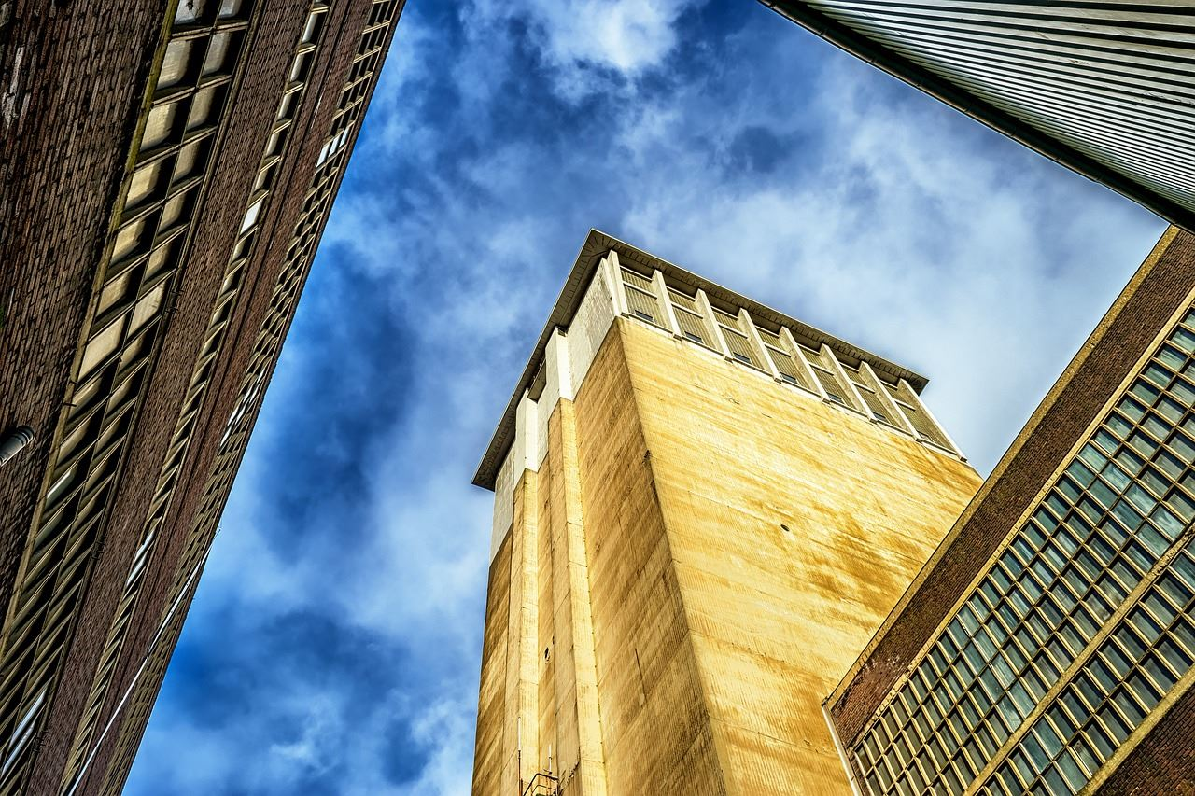
PART 04
下步工作计划
1
The user can demonstrate on a projector or computer, or presentation and make it film to be used in a wider field
2
The user can demonstrate on a projector or computer, or presentation and make it film to be used in a wider field
3
The user can demonstrate on a projector or computer, or presentation and make it film to be used in a wider field
4
The user can demonstrate on a projector or computer, or presentation and make it film to be used in a wider field
The user can demonstrate on a projector or computer, or presentation and make it film to be used in a wider field

Slide 25
PART 04
下步工作计划
标题文字添加
The user can demonstrate on a projector or computer, or presentation and make it film to be used in a wider field
The user can demonstrate on a projector or computer, or presentation and make it film to be used in a wider field
The user can demonstrate on a projector or computer, or presentation and make it film to be used in a wider field
The user can demonstrate on a projector or computer, or presentation and make it film to be used in a wider field

Slide 26
201X
感谢您的观看
The user can demonstrate on a projector or computer, or print the presentation and make it into a film to be used in a wider field
WWW.IBAOTU.COM

Slide 27
版权声明
感谢您下载包图网平台上提供的PPT作品，为了您和包图网以及原创作者的利益，请勿复制、传播、销售，否则将承担法律责任！包图网将对作品进行维权，按照传播下载次数进行十倍的索取赔偿！
1.在包图网出售的PPT模板是免版税类（RF：Royalty-Free）正版受《中国人民共和国著作法》和《世界版权公约》的保护，作品的所有权、版权和著作权归包图网所有，您下载的是PPT模板素材的使用权。
2.不得将包图网的PPT模板、PPT素材，本身用于再出售，或者出租、出借、转让、分销、发布或者作为礼物供他人使用，不得转授权、出卖、转让本协议或者本协议中的权利。
更多精品PPT模板：http://ibaotu.com/ppt/
点击进入

